Slide 1

3.7: Correlated subqueries & Rolling Calculations
DATA ANALYTICS BOOTCAMP | IRONHACK

Slide 2

How we doin’?
IRONHACK BOOTCAMP

Slide 3
LABS
IRONHACK BOOTCAMP
Units 1, 2 & 3: Deadline 15/07!

Slide 4
IRONHACK BOOTCAMP
Objectives
Write more complex correlated subqueries
Use self joins to perform rolling calculations - some examples:
Month on month change for monthly active users (MAU)
Number of retained users per month
Number of users that did not come back this month (churned users)
Differentiate binary classification and multi-class classification problems
Notes:
The purpose of this lesson is to dive deeper into correlated subqueries and write more complex queries with join statements and subqueries. We will also talk more about lag_functions, self joins and how it can be used to perform rolling calculations. We will also revisit logistic regression and go in details on how the algorithm works to make those classifications.

Slide 5
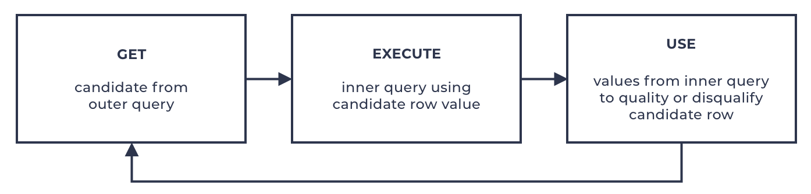
IRONHACK BOOTCAMP
Correlated Subqueries
Unlike self-contained subqueries that are executed only once during the execution of the query, correlated subqueries are executed once for each row that is processed by the main query. The picture below shows how they work:

Slide 6
IRONHACK BOOTCAMP
Correlated Subqueries
Correlated subqueries have references known as correlations to columns from tables in the outer query. They tend to be trickier to troubleshoot when problems occur because you can't run them independently. If you copy the inner query and paste it in a new window (to make it runnable), you have to substitute the correlations with constants representing sample values from your data. But then when you're done troubleshooting and fixing what you need, you have to replace the constants back with the correlations. This makes troubleshooting correlated subqueries more complex and more prone to errors.

Slide 7
IRONHACK BOOTCAMP
Correlated Subqueries + LAG()
Write a query to find the month on month monthly active users (MAU)
Use lag() function to get the active users in the previous month

Slide 8
Act. 1 | bank
IRONHACK BOOTCAMP
Keep working on the bank database.
Modify the previous query to obtain the percentage of variation in the number of users compared with previous month.
-- the previous query:
with cte_activity as (
select Active_users, lag(Active_users,1) over (partition by Activity_year) as last_month, Activity_year, Activity_month
from Monthly_active_users
)
select * from cte_activity
where last_month is not null;

Slide 9
IRONHACK BOOTCAMP
SELF JOINS
Use self joins to perform rolling calculations:
Number of retained users per month
So far we computed the total number of customers, but we are interested in the UNIQUE customer variation month to month. In other words, how many which unique customers keep renting from month to month? (customer_id present in one month and in the next one).

Slide 10
Act. 2 | bank
IRONHACK BOOTCAMP
Modify the previous queries to list the customers lost last month.

Slide 11
IRONHACK BOOTCAMP
SELF JOINS
Use self joins to perform rolling calculations:
To perform calculations such as monthly customer retention/customer churn.
Compute the change in retained customers from month to month.

Slide 12
Act. 3 | bank
IRONHACK BOOTCAMP
Use a similar approach to get total monthly transaction per account and the difference with the previous month.

Slide 13
IRONHACK BOOTCAMP
BINARY VS. MULTI-CLASS CLASSIFICATION

Slide 14
IRONHACK BOOTCAMP
CLASSIFICATION
Classification problems are those for which we want to predict a CATEGORICAL feature: ( color, brand, state, fraud/no fraud)
Only two possible values
Binary
Classification
More than two possible values
Multiclass

Slide 15
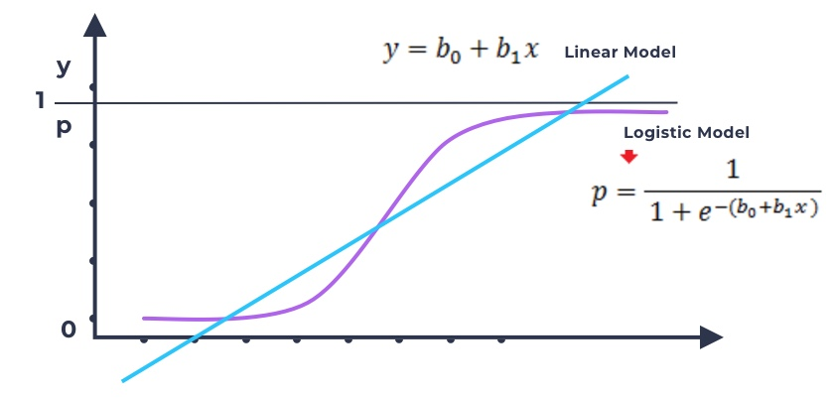
IRONHACK BOOTCAMP
BINARY CLASSIFICATION: LOGISTIC REGRESSION
P will be in the [0,1], so it can be considered as a probability of belonging to one particular class.

Slide 16
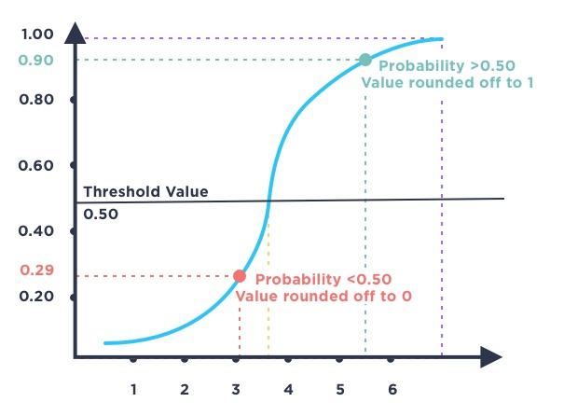
IRONHACK BOOTCAMP
DETERMINING THE PREDICTION OF THE LOGISTIC MODEL

Slide 17
IRONHACK BOOTCAMP
DETERMINING THE PREDICTION OF THE LOGISTIC MODEL
Sigmoid
Function

Slide 18
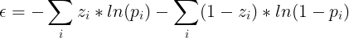
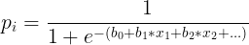
IRONHACK BOOTCAMP
DETERMINING THE LINEAR MODEL COEFFICIENTS: LOSS FUNCTION
How we can minimize the error between the prediction and the real value with a logistic regression model?
We need to find out the best coefficients to plug in the linear model in order to get the best prediction from the logistic function.
Zi is the corresponding value of a class and pi the predicted probability of belonging to a class.

Slide 19
Act. 4 | Odds
IRONHACK BOOTCAMP
The odds are defined as the probability that the event will occur divided by the probability that the event will not occur. Explain how to transform the model from linear regression to logistic regression using the logistic function.
Use this link for reference: [https://www.vebuso.com/2020/02/linear-to-logistic-regression-explained-step-by-step/ ]

Slide 20
LAB | SQL Rolling Calculations
IRONHACK BOOTCAMP

Slide 21


